Slide 1
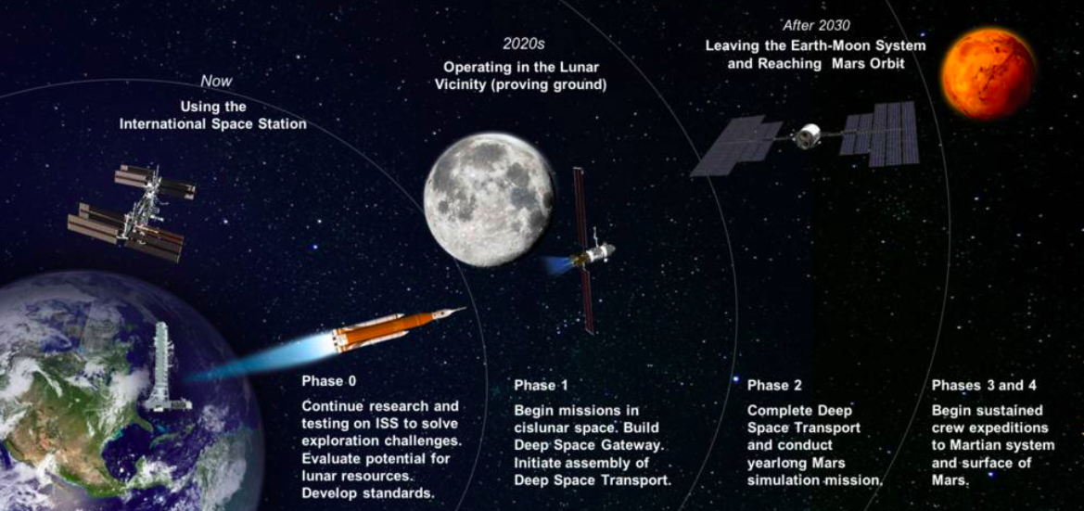
SPACE EXPLORATION

Slide 2




An Erasmus Mundus Joint Master (EMJM) in
Physiology and Medicine of Humans in Space and Extreme Environments
Ljubljana, September 20, 2022

Slide 3
The Erasmus Mundus Programme
• supports the implementation of prestigious, integrated, international Master programmes, jointly delivered by international consortia of higher education institutions (HEIs)

Slide 4
The Erasmus Mundus Programme
• supports the implementation of prestigious, integrated, international Master programmes, jointly delivered by international consortia of higher education institutions (HEIs)
• has a minimum consortium of 3 universities (HEI) from 3 countries (at least 2 from 2 different Programme Countries) – Research institutions (such as CNRS in France or Jožef Stefan Institute) cannot be partners (but can be associated partners)

Slide 5
The Erasmus Mundus Programme
• supports the implementation of prestigious, integrated, international Master programmes, jointly delivered by international consortia of higher education institutions (HEIs)
• has a minimum consortium of 3 universities (HEI) from 3 countries (at least 2 from 2 different Programme Countries) – Research institutions (such as CNRS in France or Jožef Stefan Institute) cannot be partners (but can be associated partners)
• provides a high degree of integration and excellent academic content.

Slide 6
The Erasmus Mundus Programme
• supports the implementation of prestigious, integrated, international Master programmes, jointly delivered by international consortia of higher education institutions (HEIs)
• has a minimum consortium of 3 universities (HEI) from 3 countries (at least 2 from 2 different Programme Countries) – Research institutions (such as CNRS in France or Jožef Stefan Institute) cannot be partners (but can be associated partners)
• provides a high degree of integration and excellent academic content.
• requires compulsory physical mobility for all recruited students.

Slide 7
The Erasmus Mundus Programme
• supports the implementation of prestigious, integrated, international Master programmes, jointly delivered by international consortia of higher education institutions (HEIs)
• has a minimum consortium of 3 universities (HEI) from 3 countries (at least 2 from 2 different Programme Countries) – Research institutions (such as CNRS in France or Jožef Stefan Institute) cannot be partners (but can be associated partners)
• provides a high degree of integration and excellent academic content.
• requires compulsory physical mobility for all recruited students.
• provides important financial support to institutions (750€/student/month) and scholarships to the best candidates worldwide (1,400€/month/student, max 33,600€ per student).

Slide 8
The Erasmus Mundus Programme
• supports the implementation of prestigious, integrated, international Master programmes, jointly delivered by international consortia of higher education institutions (HEIs)
• has a minimum consortium of 3 universities (HEI) from 3 countries (at least 2 from 2 different Programme Countries) – Research institutions (such as CNRS in France or Jožef Stefan Institute) cannot be partners (but can be associated partners)
• provides a high degree of integration and excellent academic content.
• requires compulsory physical mobility for all recruited students.
• provides important financial support to institutions (750€/student/month) and scholarships to the best candidates worldwide (1,400€/month/student, max 33,600€ per student).
• requires mandatory participation of international scholars.

Slide 9
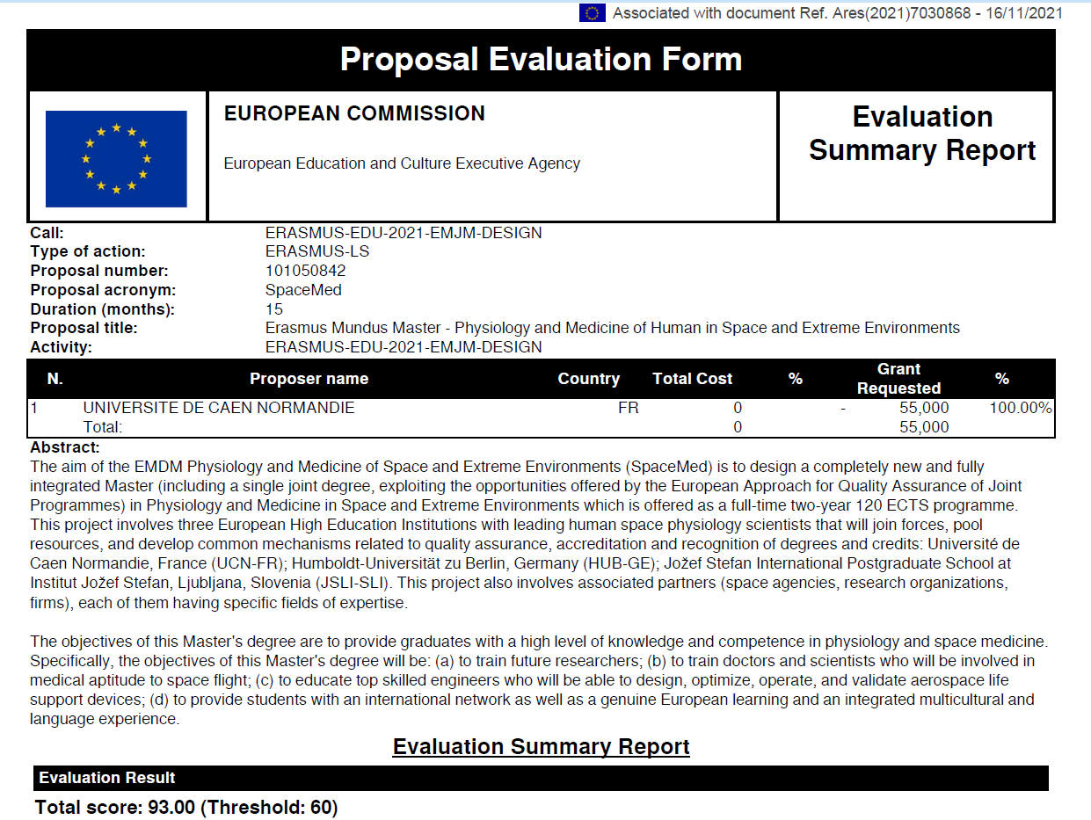
In January 2022, SpaceMed received a short-term (15-month) grant (55k€) to support the establishment of a joint Erasmus Mundus Master Programme.
Notes:
In January, in the framework of the EMDM, we were selected and received a short-term (15 months) grant (55k€) to support us in the implementation of the SpaceMed project.

Slide 10
• Curriculum: places strong emphasis on hands-on activities in state-of-the-art laboratories and on field studies, including space flight analogues (i.e., parabolic flights, Antarctic habitats, experimental bed rest studies, etc.), and extreme environments, such as those experienced at high altitude, underwater, and in hot and cold, dry and humid environments.

Slide 11
• Curriculum: places strong emphasis on hands-on activities in state-of-the-art laboratories and on field studies, including space flight analogues (i.e., parabolic flights, Antarctic habitats, experimental bed rest studies, etc.), and extreme environments, such as those experienced at high altitude, underwater, and in hot and cold, dry and humid environments.
• Career perspectives: provides training for those interested in pursuing a research career in space life sciences and extreme environments, as well as for medical doctors who would be able to offer medical support for future commercial space flights. The course will also provide valuable training to biomedical engineers who will be able to design, optimise, operate, and validate aerospace life support devices.

Slide 12
• Curriculum: places strong emphasis on hands-on activities in state-of-the-art laboratories and on field studies, including space flight analogues (i.e., parabolic flights, Antarctic habitats, experimental bed rest studies, etc.), and extreme environments, such as those experienced at high altitude, underwater, and in hot and cold, dry and humid environments.
• Career perspectives: provides training for those interested in pursuing a research career in space life sciences and extreme environments, as well as for medical doctors who would be able to offer medical support for future commercial space flights. The course will also provide valuable training to biomedical engineers who will be able to design, optimise, operate, and validate aerospace life support devices.
• Strengths
- Small class sizes and close interaction with teaching staff.
- Science teaching and training with innovative and interdisciplinary methodologies.
- Research projects involving laboratory and field studies
- Workshops bringing together students, academics and industry professionals.
- Involving students in space projects supported by German, French, European and US space agencies.
- Offering students an international network and an integrated multicultural and linguistic experience.
- Immersion in at least three European cultural regions (France, Germany, Slovenia)
- Attractive scholarships.

Slide 13
Duration
2 years (full-time), 120 ECTS

Slide 14
Duration
2 years (full-time), 120 ECTS
Admission requirements
Either a Bachelor’s degree in natural sciences or kinesiology (180 ECTS), a Master degree in engineering, or a medical degree.
A minimum level of English language proficiency equivalent to B2 according to the levels defined by the Common European Framework of Reference for Languages (CEFR)

Slide 15
Duration
2 years (full-time), 120 ECTS
Admission requirements
Either a Bachelor’s degree in natural sciences or kinesiology (180 ECTS), a Master degree in engineering, or a medical degree.
A minimum level of English language proficiency equivalent to B2 according to the levels defined by the Common European Framework of Reference for Languages (CEFR)
Academic cooperation
Collaboration between 3 research and educational institutions to award a joint degree:
- La Charité at Humboldt-Universität zu Berlin (Germany)
- International Postgraduate School Jožef Stefan (Ljubljana, Slovenia)
- Université de Caen Normandie (France).

Slide 16
Duration
2 years (full-time), 120 ECTS
Admission requirements
Either a Bachelor’s degree in natural sciences or kinesiology (180 ECTS), a Master degree in engineering, or a medical degree.
A minimum level of English language proficiency equivalent to B2 according to the levels defined by the Common European Framework of Reference for Languages (CEFR)
Academic cooperation
Collaboration between 3 research and educational institutions to award a joint degree:
- La Charité at Humboldt-Universität zu Berlin (Germany)
- International Postgraduate School Jožef Stefan (Ljubljana, Slovenia)
- Université de Caen Normandie (France).
Associated partners (academic and research institutions, space agencies, and industrial partners)
Involved in programme definition and management, teaching, and hosting of students during internships.

Slide 17



Course schedule
ECTS 13 7 10 10 10 10 10 10 10 30
U8: Seminar 2
U9: Thesis proposal - pilot
U10: MS thesis project
U4: Seminar 1
U5: Internship
U7: Advanced practices
U2: Study models, Ethics
U6: Advanced methods
Induction week
U1: Basics – Physiology
U3: Signal analysis
statistics
Workshop
Teachears from Berlin, Caen, Ljubljana…
Berlin, Caen, Ljubljana, associated partners…
Direct integration in M2
Semester 1 2 3 4
October February March September October February March September
Notes:
Only one track, all the students will go together at the same places, except for internship during S2 and S4

Slide 18
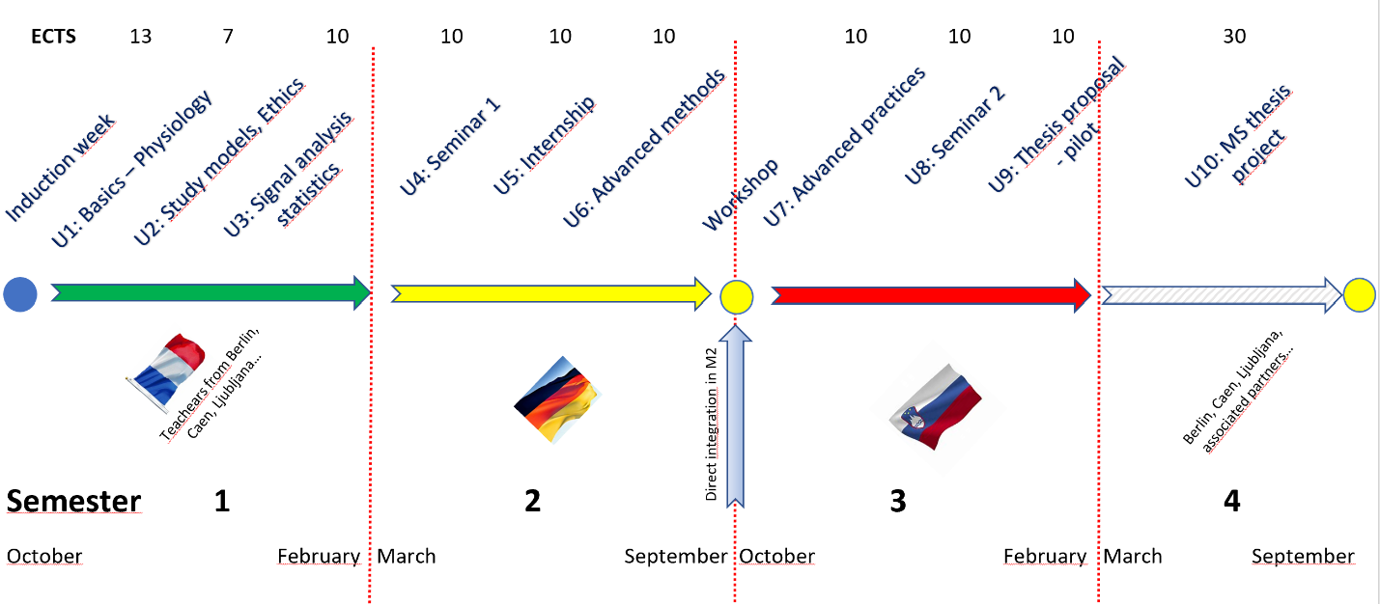
Course Structure
Biomedical
Physiology
Environmental
Physiology
Extreme
Environments
Thesis
• Physiology of extreme environments • Hands on activities in research and clinical laboratories • Practical demonstrations (e.g., parabolic flight) • Ethics in research • Data analysis • Statistical procedures | Introduction to advanced measurement methods (exercise, body composition, multisensory measurement, climate change) | • Human habitats • Spaceflight-associated musculoskeletal atrophy & cardiovascular deconditioning • Circadian rhythms, sleep and nutrition • Space Ergonomics, including human-robot interaction | Six-month research project or industrial placement. The culmination of all semesters will lead to the awarding of a Master Thesis
Notes:
Extreme environments: hypoxia, hypercapnia, hypobaric, hyperbaric conditions
Hypothermia, hyperthermia
Gravity and accelerations
Stress, isoclation, confinement, chronobiology
Hypoactivity, sedendarity
Spaceflight

Slide 19
Timeline
Grant Agreement
EMDM funding (55k€)
Current status
EMDM Application
Start accreditation
Procedure
EMJM Application
Start EMJM
First students
17/06/2021
01/2022
08/2022
02/2023
09/2023
09/2024
EMDM funding (15 months)
Preparation year
Notes:
EQAR means European Approach for Quality Assurance
Accredition procedure has to comply with the European Approach for Quality Assurance

Slide 20
Associated partners
participate in periodic reviews of SpaceMed programme to ensure high academic quality and further development of the programme

Slide 21
Associated partners
• participate in periodic reviews of SpaceMed programme to ensure high academic quality and further development of the programme
• contribute to student’s employability by ensuring that academic content of courses meets relevant professional needs

Slide 22
Associated partners
• participate in periodic reviews of SpaceMed programme to ensure high academic quality and further development of the programme
• contribute to student’s employability by ensuring that academic content of courses meets relevant professional needs
• offer complementary skills, courses and/or internship/placement possibilities or other field experiences

Slide 23
Associated partners
• participate in periodic reviews of SpaceMed programme to ensure high academic quality and further development of the programme
• contribute to student’s employability by ensuring that academic content of courses meets relevant professional needs
• offer complementary skills, courses and/or internship/placement possibilities or other field experiences
• provide links with relevant stakeholders

Slide 24
Associated partners
• participate in periodic reviews of SpaceMed programme to ensure high academic quality and further development of the programme
• contribute to student’s employability by ensuring that academic content of courses meets relevant professional needs
• offer complementary skills, courses and/or internship/placement possibilities or other field experiences
• provide links with relevant stakeholders
• provide research topics and/or assist in research and/or technical work

Slide 25
Associated partners
• participate in periodic reviews of SpaceMed programme to ensure high academic quality and further development of the programme
• contribute to student’s employability by ensuring that academic content of courses meets relevant professional needs
• offer complementary skills, courses and/or internship/placement possibilities or other field experiences
• provide links with relevant stakeholders
• provide research topics and/or assist in research and/or technical work
• guest lectures

Slide 26
Associated partners
• participate in periodic reviews of SpaceMed programme to ensure high academic quality and further development of the programme
• contribute to student’s employability by ensuring that academic content of courses meets relevant professional needs
• offer complementary skills, courses and/or internship/placement possibilities or other field experiences
• provide links with relevant stakeholders
• provide research topics and/or assist in research and/or technical work
• guest lectures
• contribute to SpaceMed sustainability
  sourcing additional revenues/resources including scholarship for students-
  supporting implementation, organization and promotion of the SpaceMed

Slide 27

http://www.esa.int/Our_Activities/Human_Spaceflight/Research
Jennifer Ngo-Anh@esa.int

Slide 29
What is the Erasmus Mundus Programme?
Erasmus Mundus supports the implementation of prestigious, integrated, international Master programmes, jointly delivered by international consortia of HEIs
Minimum consortium of 3 universities (HEI) from 3 countries (at least 2 from 2 different Programme Countries) – Research institutions (such as CNRS in France or Jozef Stefan Institut) cannot be partners (but can be associated partners)
The specificity of these Master programmes lies in the high degree of jointness/integration and the excellent academic content and methodology offered.
Compulsory physical mobility for all recruited students (in at least 2 countries of the Programme Countries represented in the consortium)
It provides important financial support to institutions (750€/student/month) and scholarships to the best candidates worldwide (1,400€/month/student, max 33,600€ per student).
Mandatory participation of international scholars (previously Min 4 invited scholars for a min. total duration of 8 weeks)
Notes:
jointness : organisation of curricula, admission procedures, services to students, type of degree, accreditation procedure...

